Slide 1
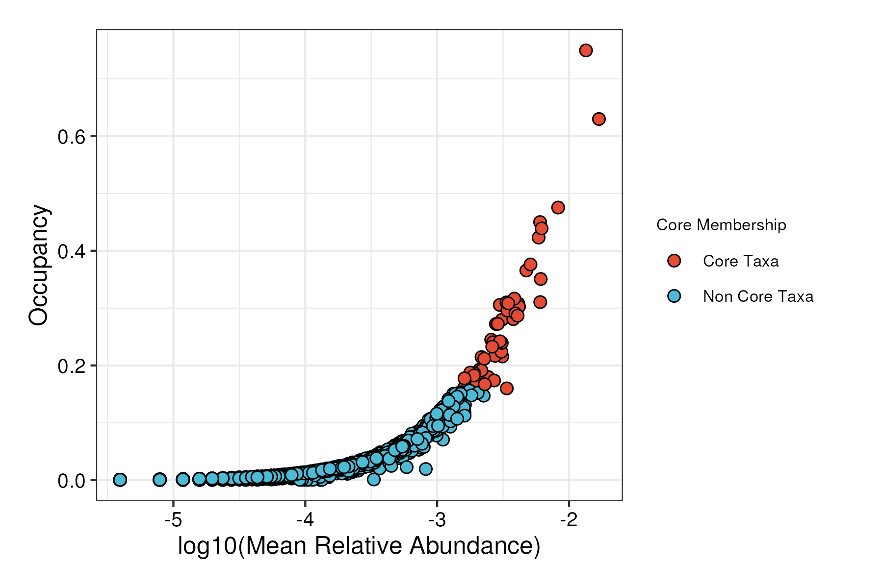
Bray-Curtis Core (all BRCs)

Slide 2
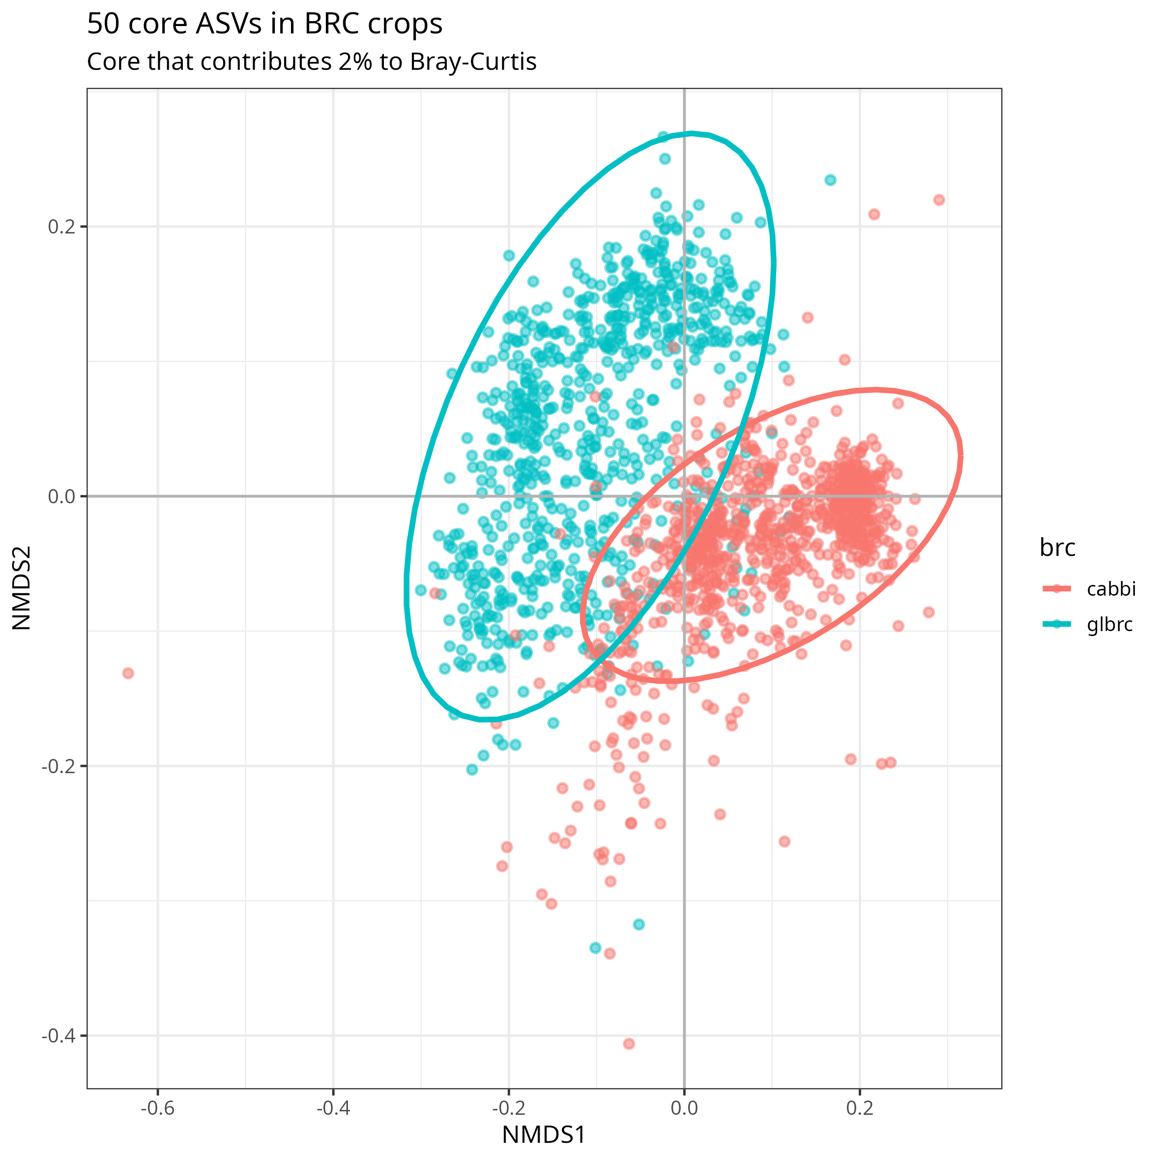
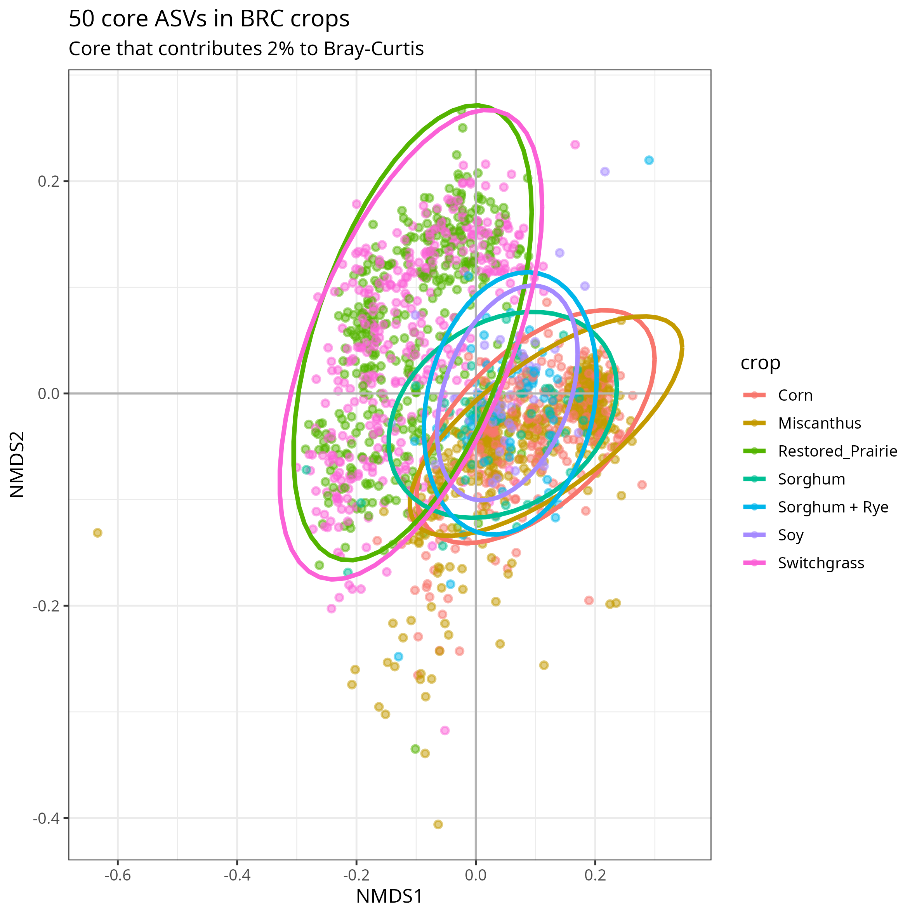
Bray-Curtis Core (all BRCs)
NMDS

Slide 3
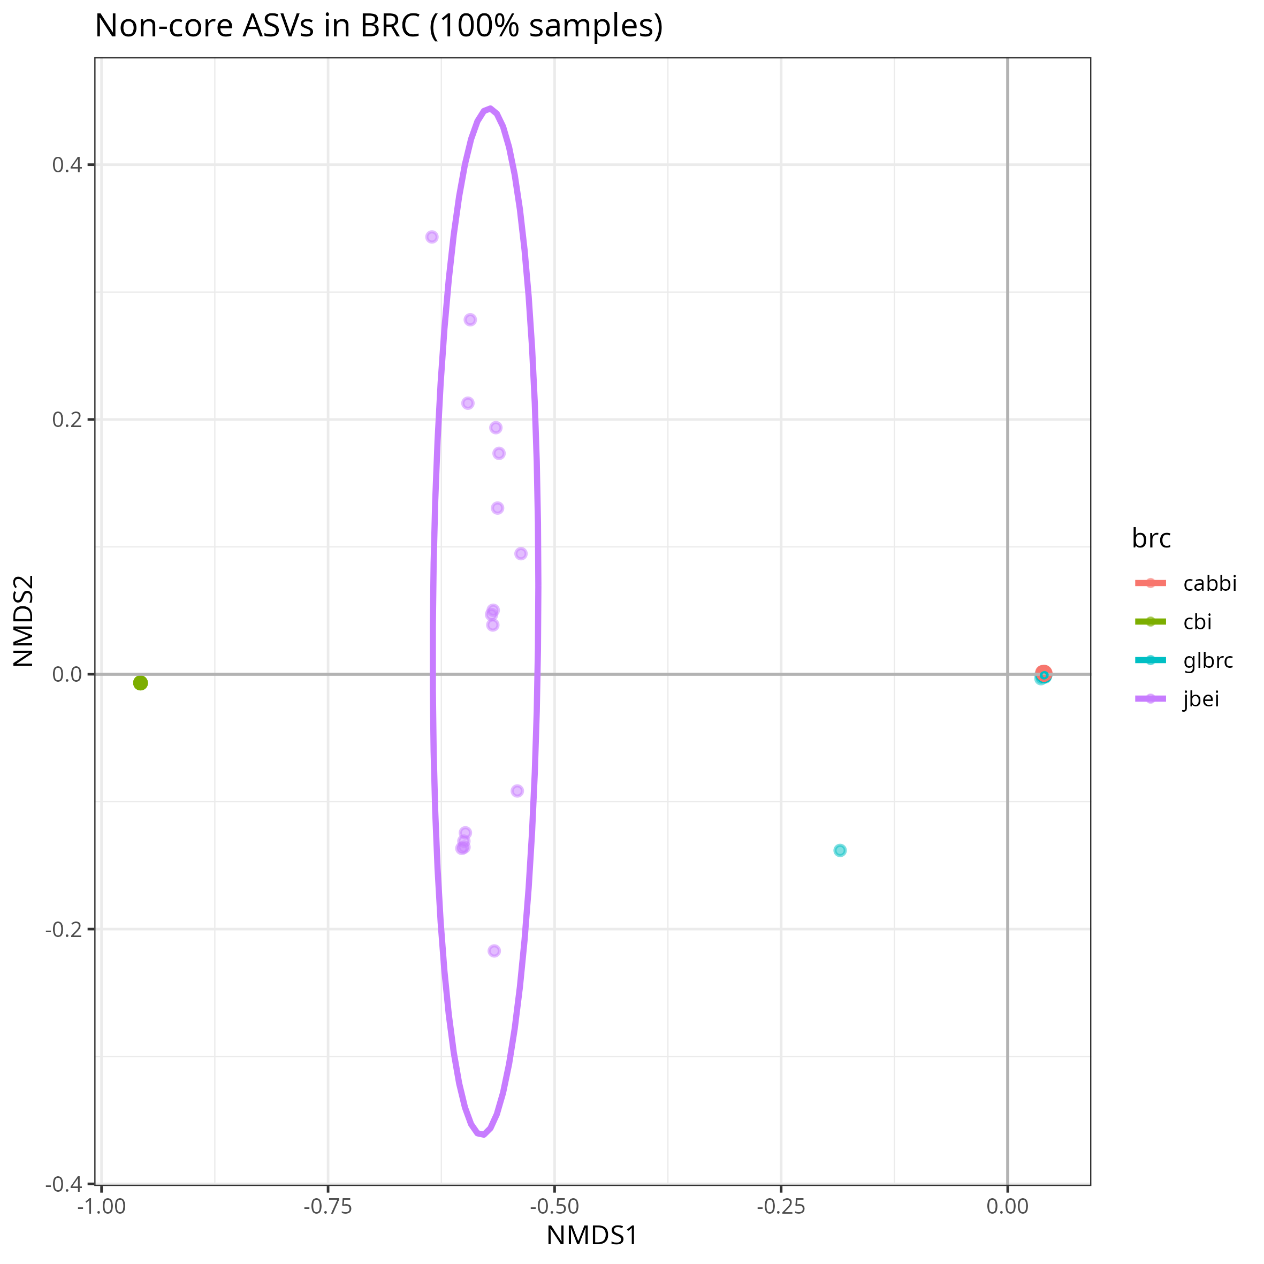
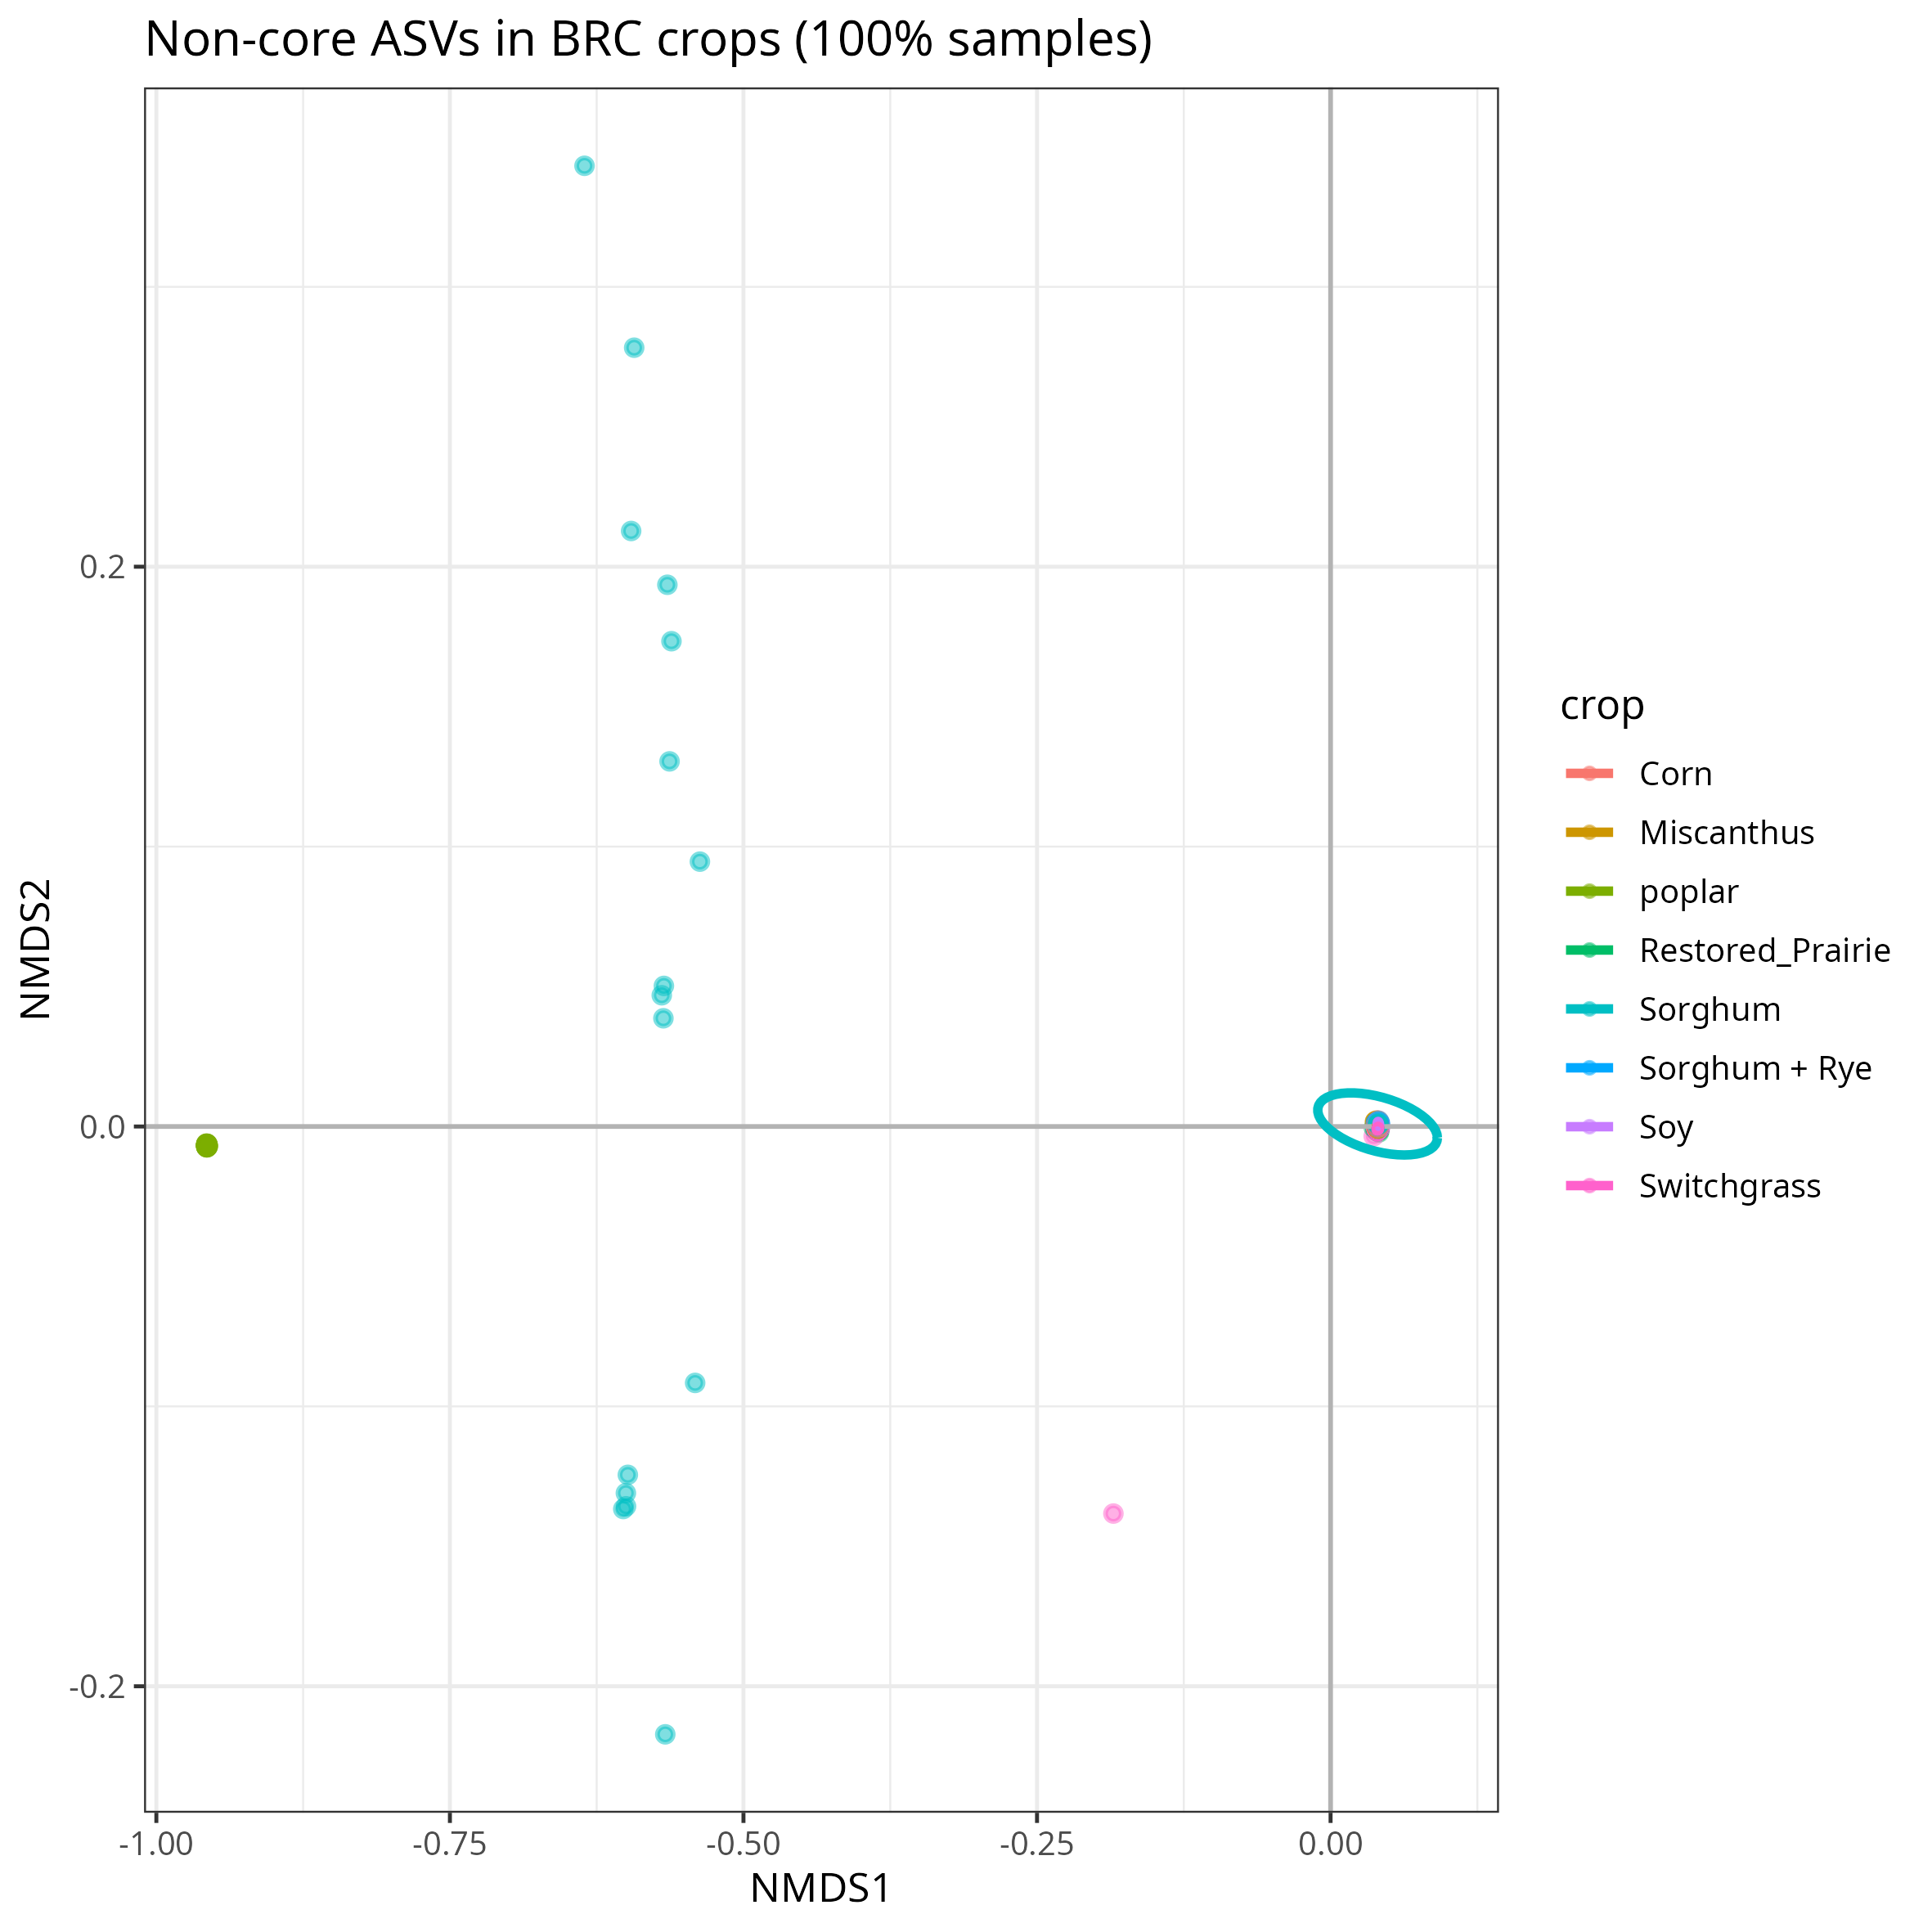
Bray-Curtis Non-Core (all BRCs)
NMDS

Slide 4
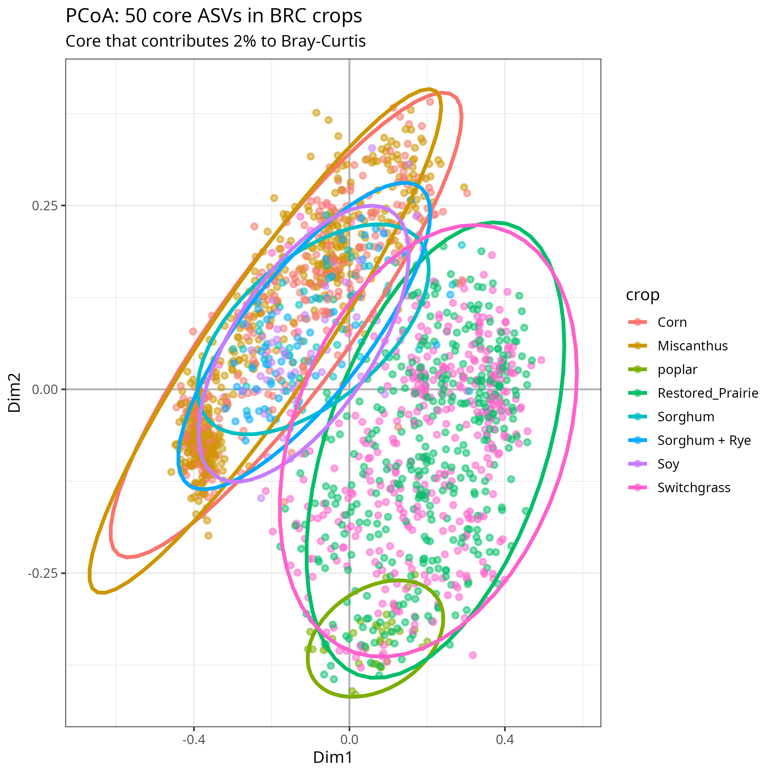
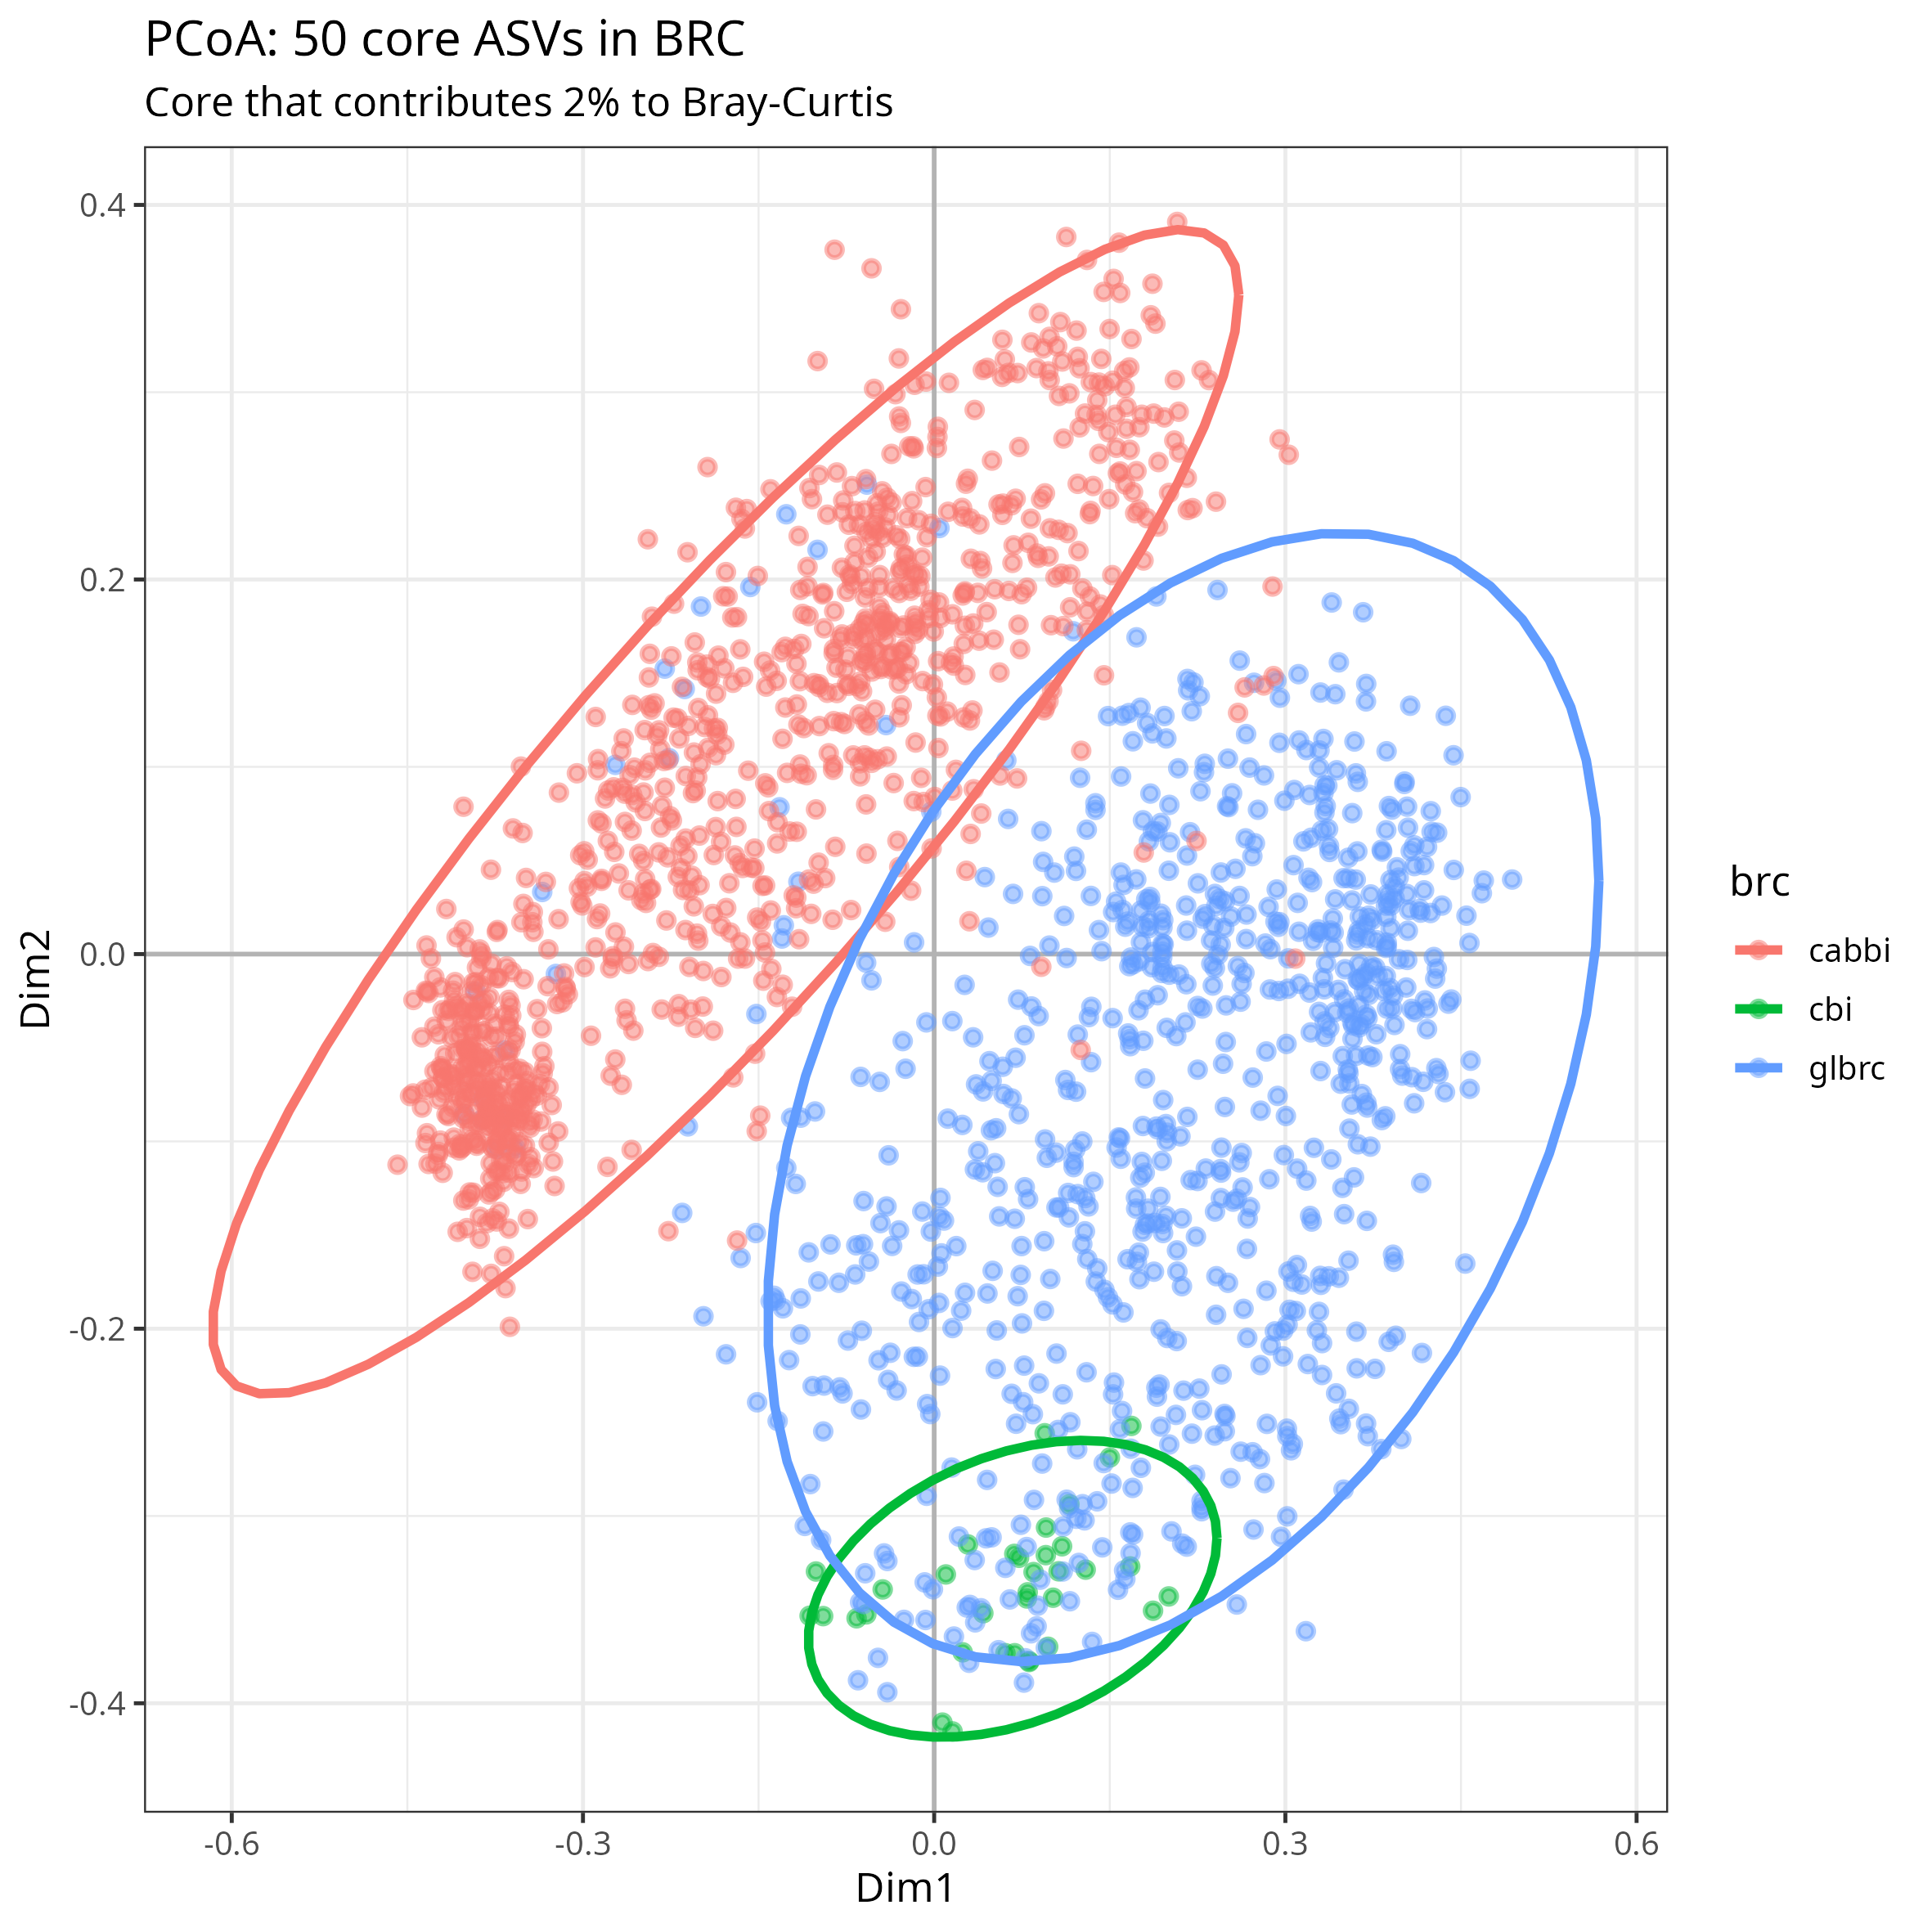
Bray-Curtis Core (all BRCs)
PCoA

Slide 5
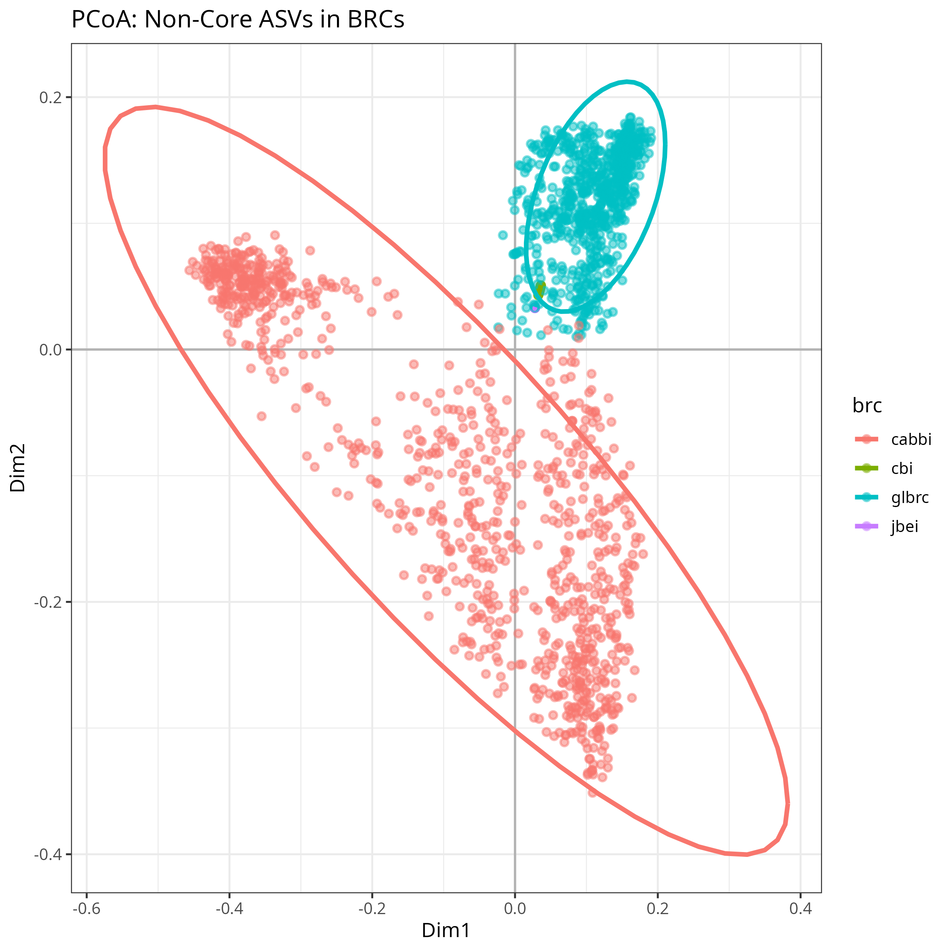
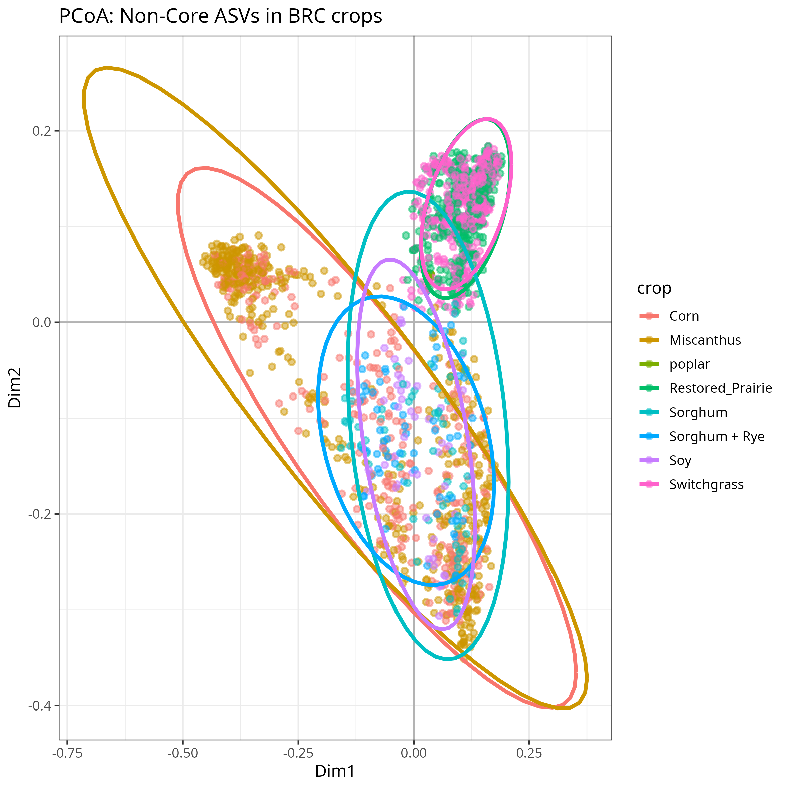
Bray-Curtis Non-Core (all BRCs)
PCoA

Slide 6
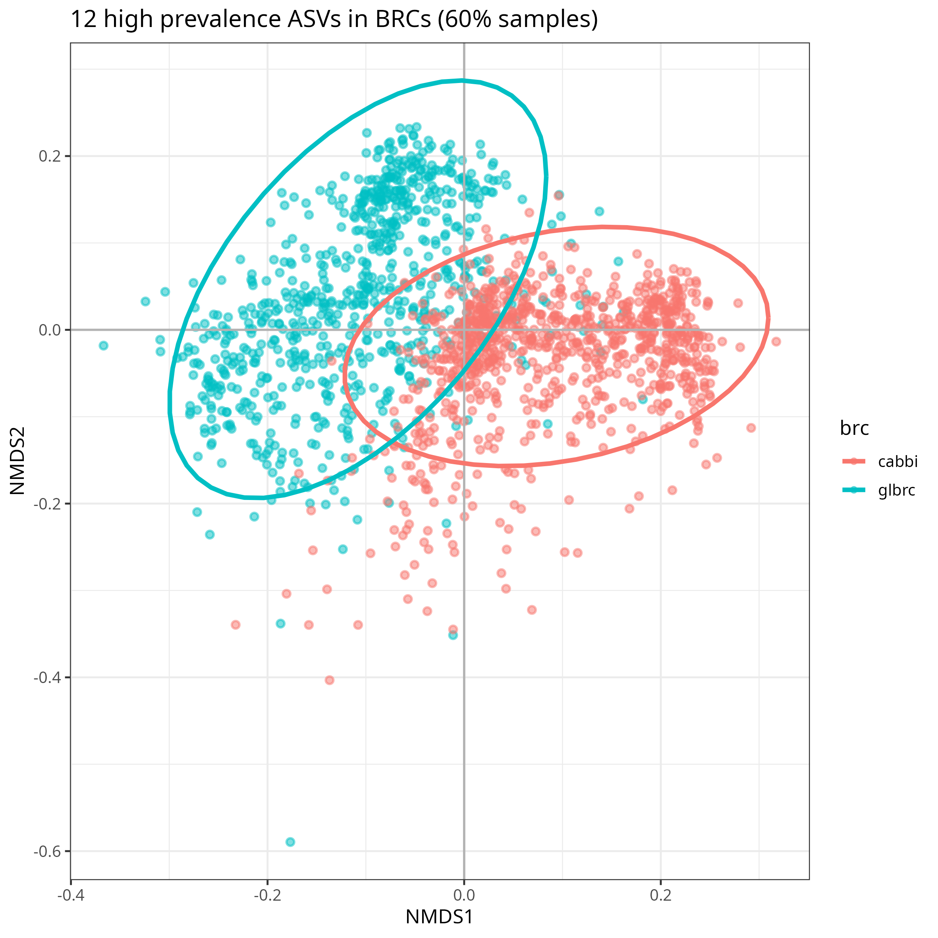
Bray-Curtis core vs. 60% threshold cut-off

Slide 7
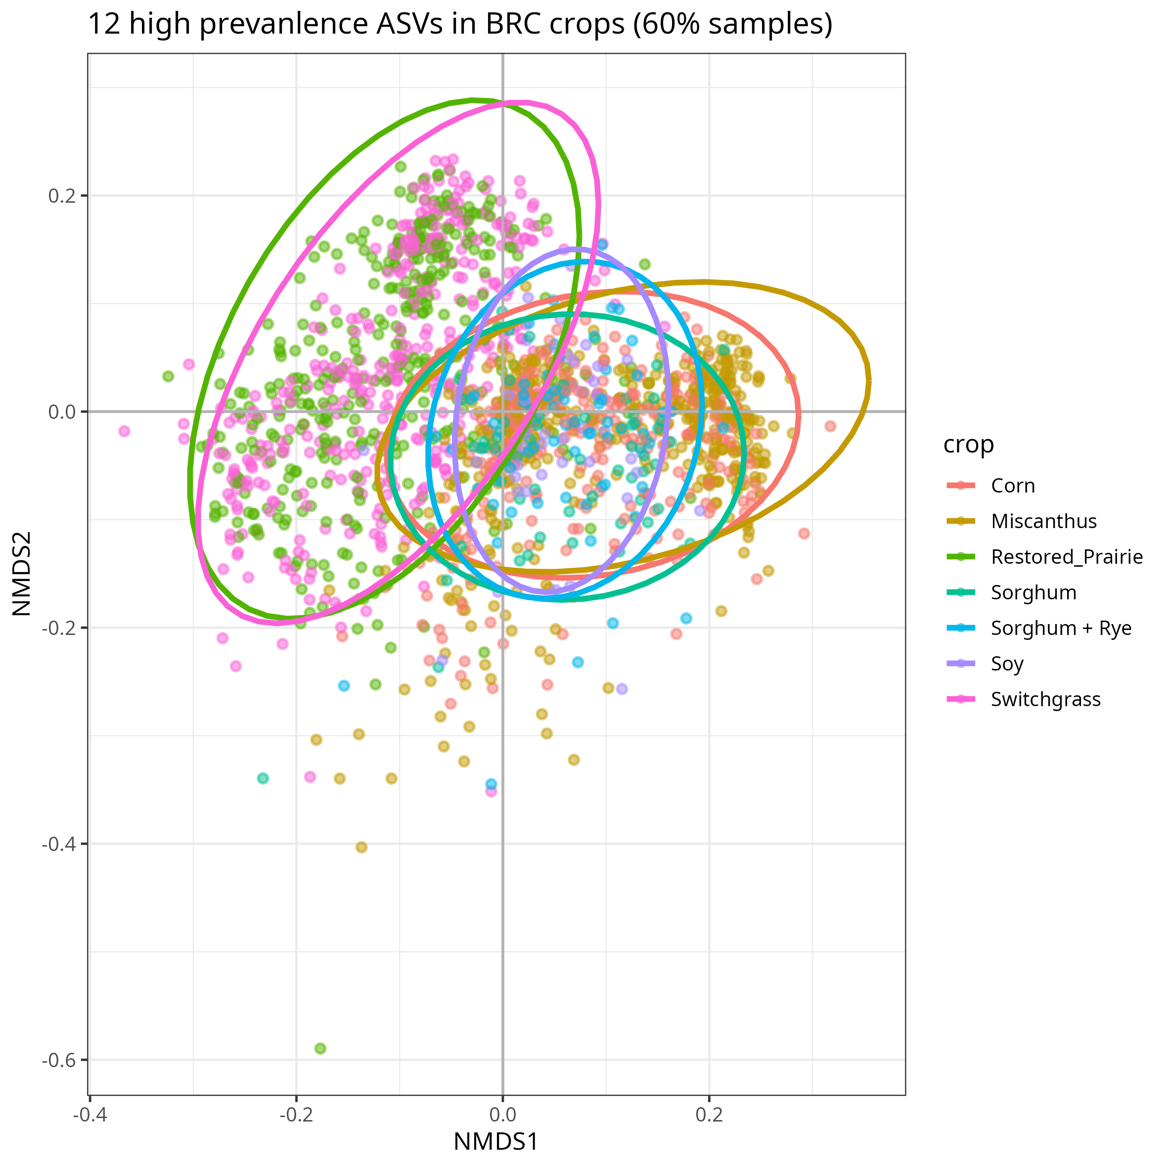
Bray-Curtis core vs. 60% threshold cut-off

Slide 8
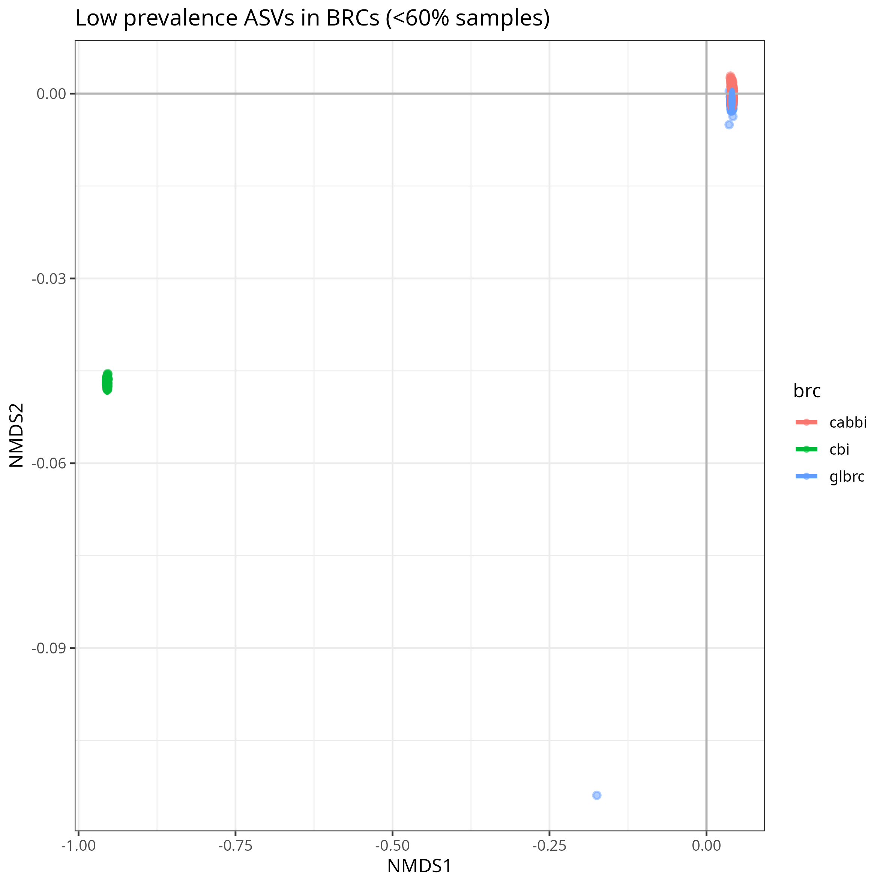
Bray-Curtis core vs. 60% threshold cut-off

Slide 9

Bray-Curtis core vs. 60% threshold cut-off

Slide 10
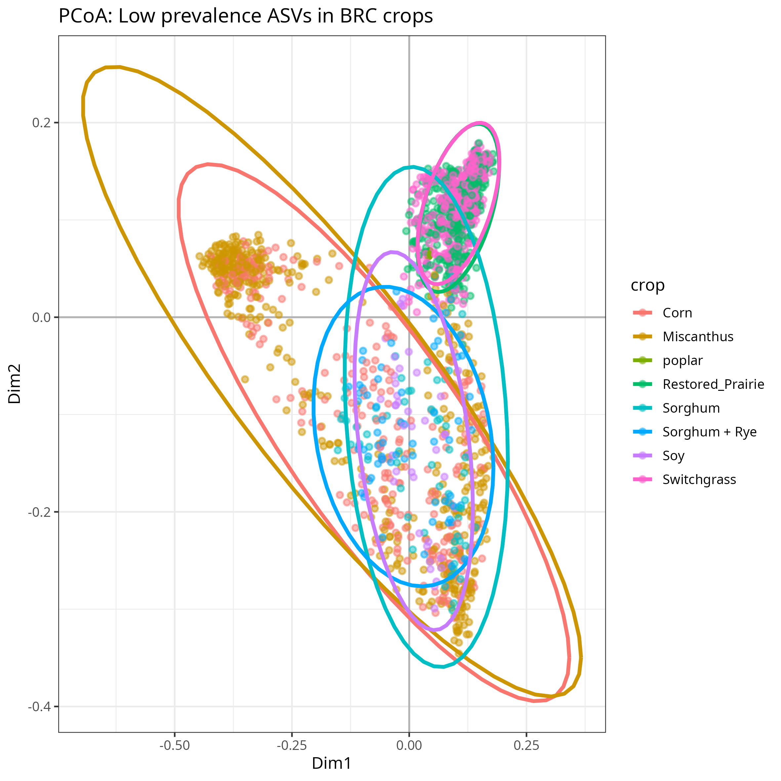
Bray-Curtis core vs. 60% threshold cut-off

Slide 11
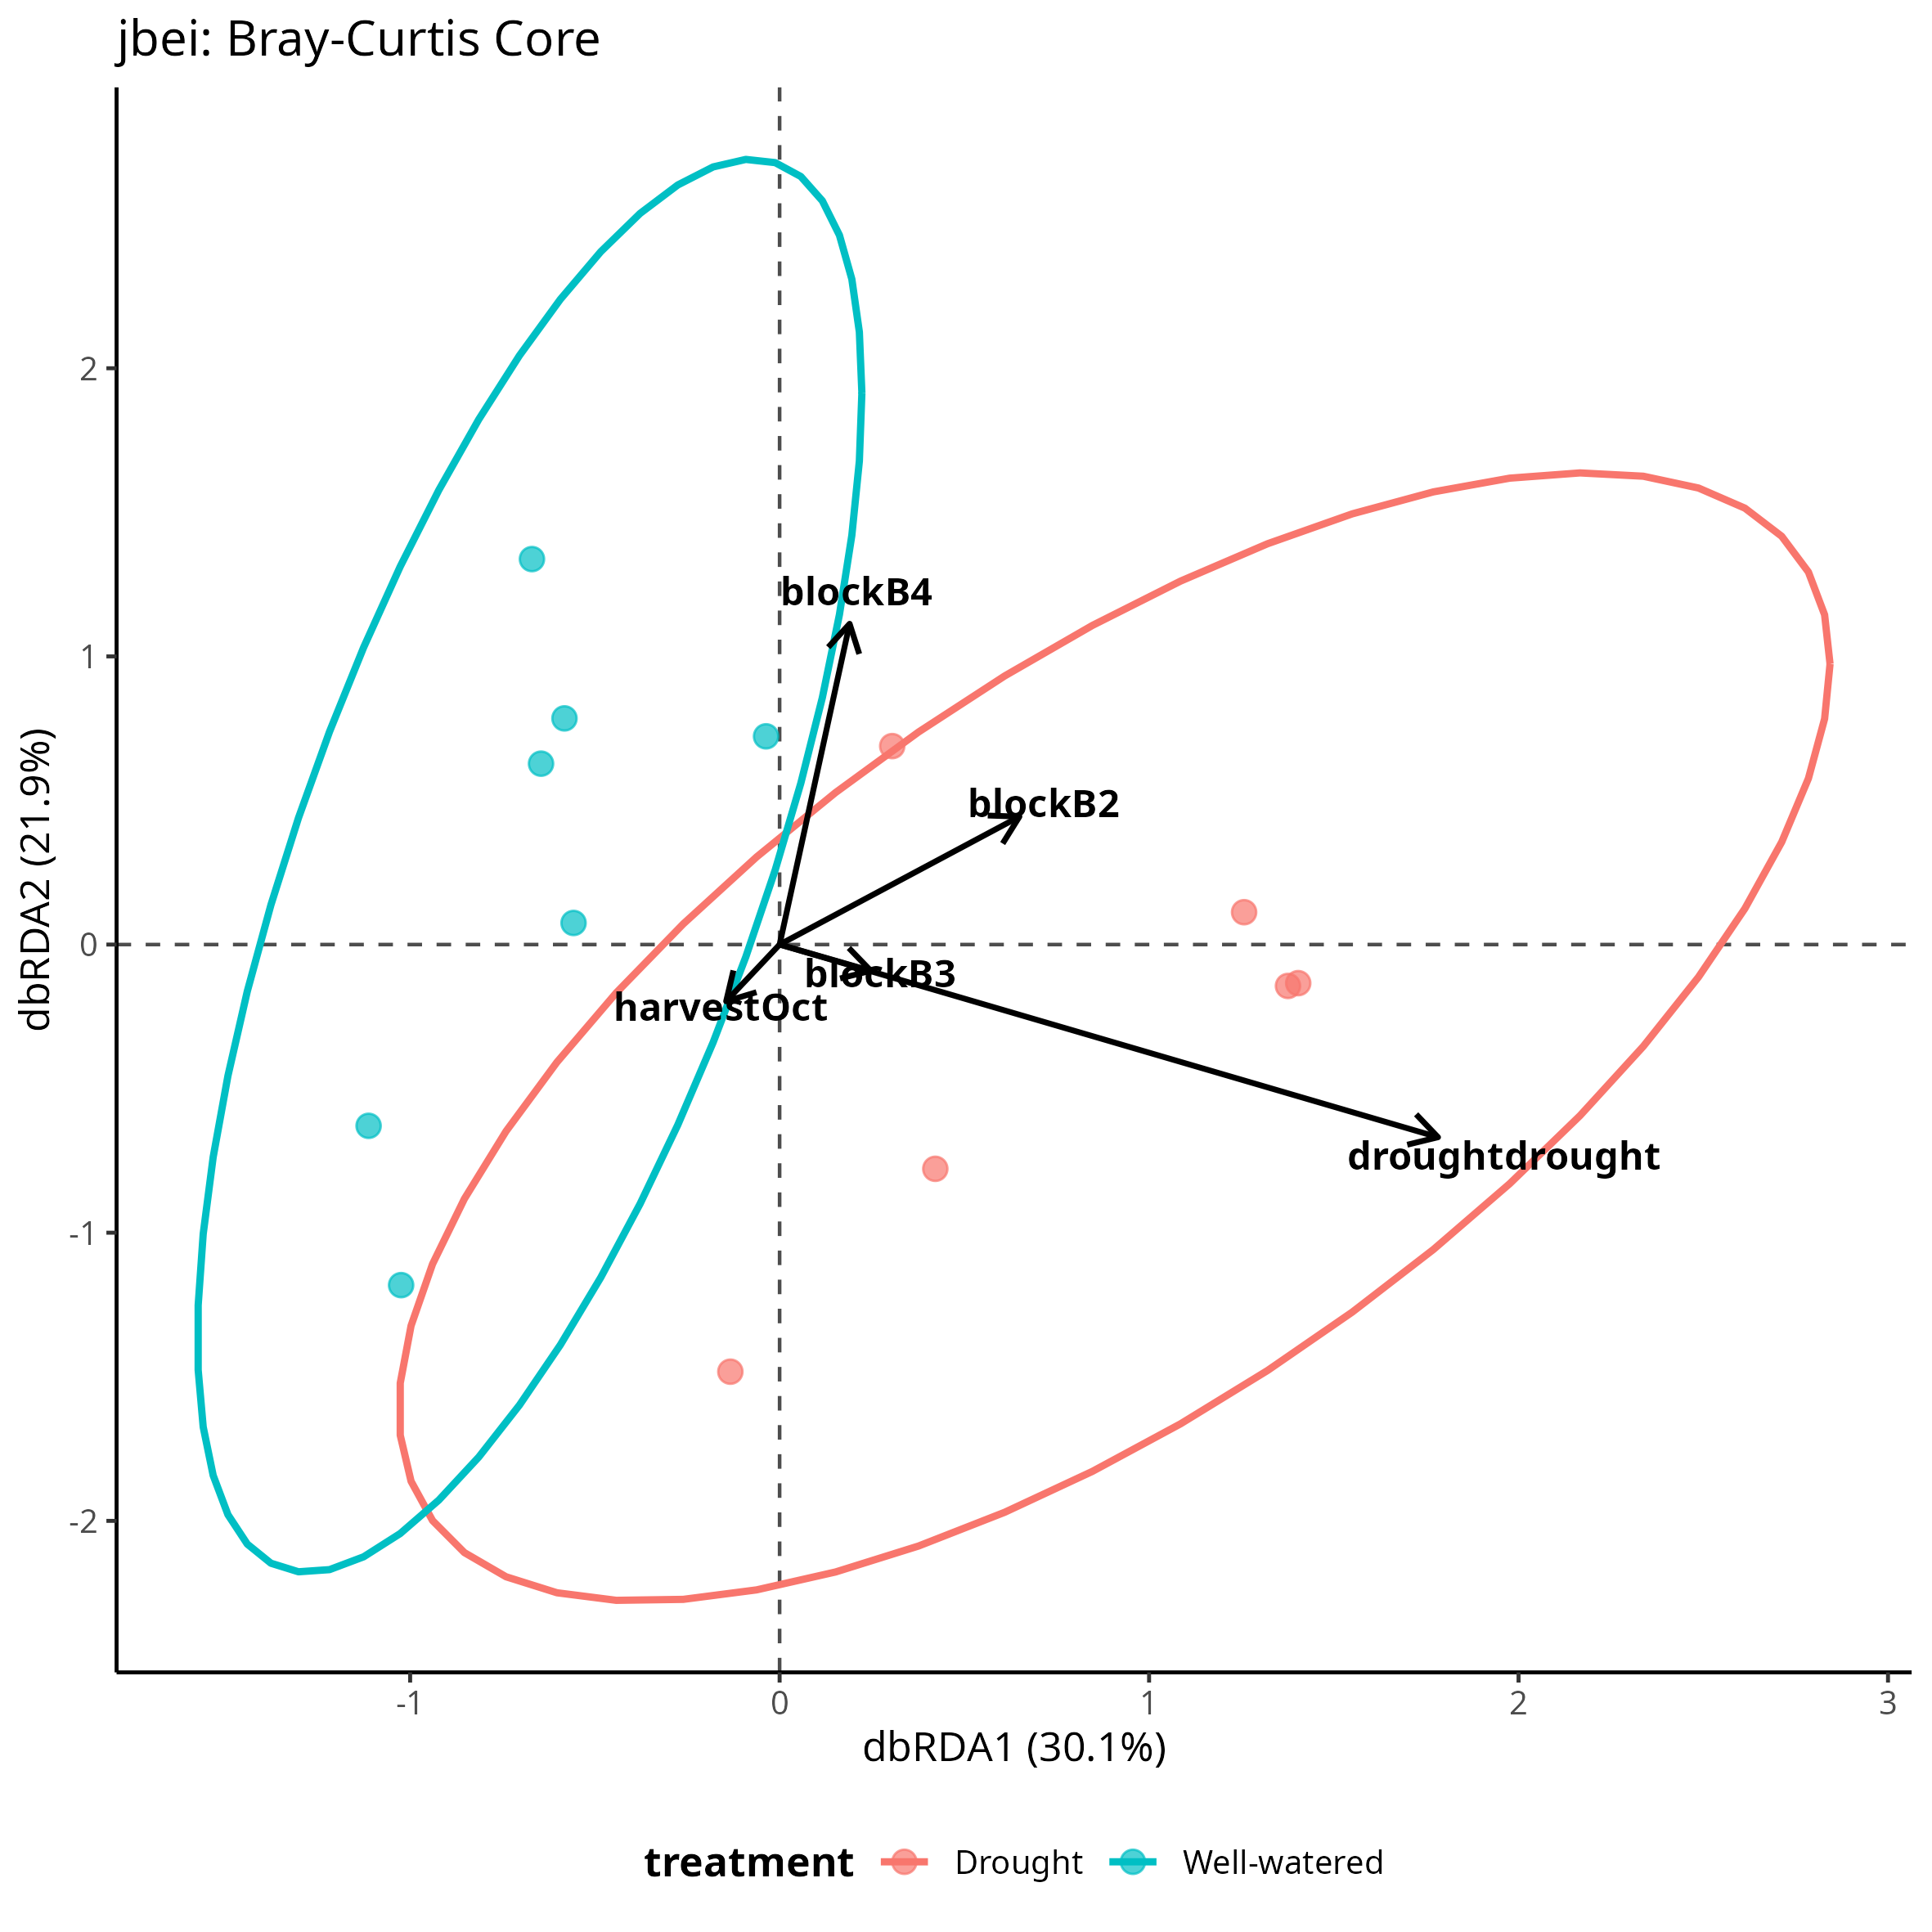
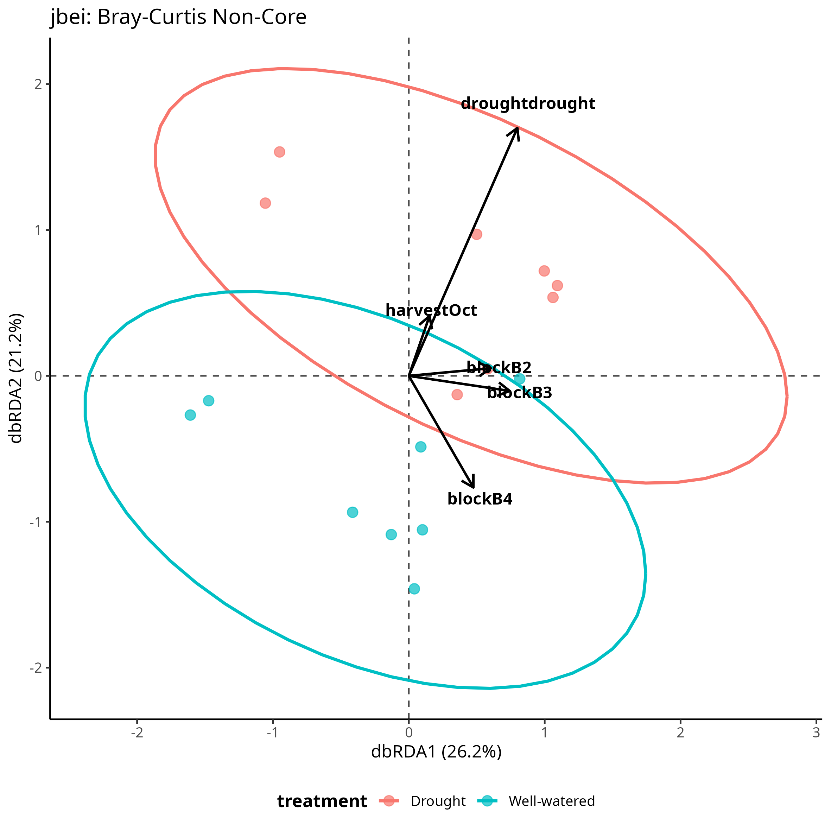
Extra

Slide 12
Take aways
Microbial core between BRCs are quite different regardless of crop – site and ontology matters
Crops grown in same site/environment share microbial core – crops are more similar within sites than between
Core or non-core taxa tell the same story regardless of how se define “core”.

